Slide 1
Master in Applied &
Computational Mathematics
BNumMet
A Scholar implementation of Numerical Methods in Python enhanced with interactive widgets
Author: Fernando Bellido Pazos
Tutor: Juan Manuel Perez Pardo
End of Master’s Thesis: Defense

Slide 2
Contents
Introduction
State of the art
Objectives
Software Development
Results
Linear Systems
Interpolation
Non-Linear Equation Solver
Least Squares
Random Number Generator
Ending Remarks

Slide 3

State of the Art
Numerical Computing With MATLAB – Cleve B.Moler
Programming Language: MATLAB
11 Chapters : Code & Visualization
Private Licensed
Graphical User Interface: Not Intuitive and user-friendly
MATLAB’s Home License: 119€

Slide 4

State of the Art
End of Degree’s Thesis – Juan Camilo Bucheli
Programming Language: Python
2 Packages: Linear Systems & Interpolation
Open Source Licensed (Apache 2.0)
Graphical User Interface: NOT functional to this day
Language: Spanish

Slide 5
Objectives
Scholar Numerical Method
Graphical User Interface
BNumMet
Students

Slide 6
Objectives
General Code
Open Source
English
G.U.I.
Provide Insight on algorithm
Modular on Input
PC-Human Interaction theory
Efficiency
Self-Contained
Easy to use
Interact and observe changes Dynamically
Easy to Read
Functional

Slide 7
Software Development
Initiation
Roles
Life Cycle Model: Iterative Life Cycle
Planning
Schedule Frame: October 2022 - 15 June in 2 Week Iterations
Execution
Quality Assurance: Unit Test & SonarQube
Software Configuration Management: Github & vX.Y.Z Scheme
Ending
Packaging: PIP & Public Github
Development Framework: Python $≥3.8$ & Jupyter
Development Framework: Python ≥3.8 & Jupyter
Licensing: GNU Affero General Public Licence v3.0
Future Development

Slide 8
Results

Slide 9
Linear Systems
Packages
LU Decomposition*
Forward & Backward Substitution
QR Decomposition
LU Solver
QR Solver

Slide 10
Linear Systems
Discussion: LU Decomposition
$$A′[row, col+ 1 : n] ← A′[row, col + 1 : n] − multiplier·A′[col, col + 1 : n]$$
𝐴′[𝑟𝑜𝑤, 𝑐𝑜𝑙+ 1 : 𝑛] ← 𝐴′[𝑟𝑜𝑤, 𝑐𝑜𝑙 + 1 : 𝑛] − 𝑚𝑢𝑙𝑡𝑖𝑝𝑙𝑖𝑒𝑟·𝐴′[𝑐𝑜𝑙, 𝑐𝑜𝑙 + 1 : 𝑛]
Submatrices Syntax
New-Axis Syntax
Outer Product
For Loop

Slide 11
Linear Systems
Discussion: LU Decomposition
Submatrices Syntax
Outer Product
A[col + 1 :, col] = A[col + 1 :, col] / pivot
A[col + 1 :, col + 1 :] = A[col + 1 :, col + 1 :] - (A[col + 1 :, :][:, [col]] @ A[[col], :][:, col + 1 :])
A[col + 1 :, col] = A[col + 1 :, col] / pivot
A[col + 1 :, col + 1 :] = np.outer(A[col + 1 :, col], A[col, col + 1 :])
New-Axis Syntax
For Loop
A[col + 1 :, col] = A[col + 1 :, col] / pivot
A[col + 1 :, col + 1 :] = A[col + 1 :, col][:, np.newaxis] @ A[col, col + 1 :][np.newaxis, :]
for row in range(col + 1, n):
A[row, col] = A[row, col] / A[col, col]
A[row, col + 1 :] = A[row, col + 1 :] - A[row, col] * A[col, col + 1 :]

Slide 12
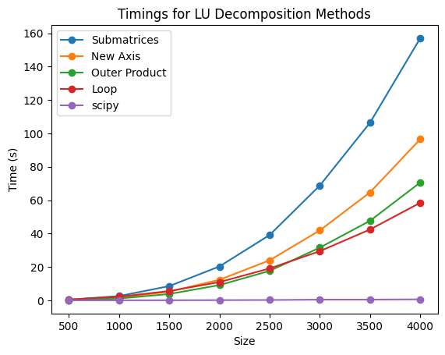
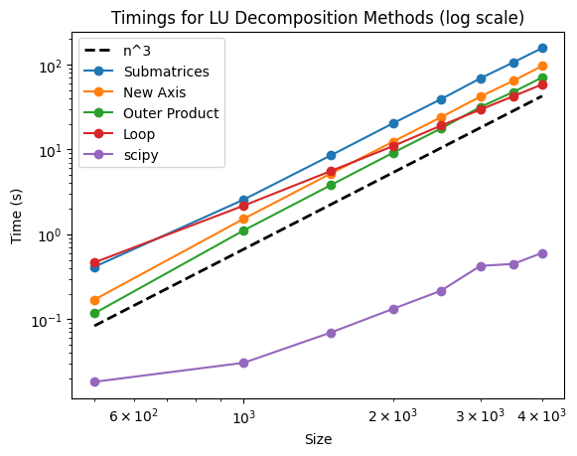
Linear Systems
Discussion: LU Decomposition

Slide 13
Linear Systems
Discussion: LU Decomposition
 | Submatrices | New Axis | Outer Product | Loop | Scipy
Slope | 2.8852 | 3.0434 | 3.0717 | 2.3340 | 1.8136

Slide 14
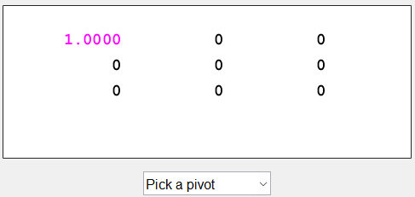
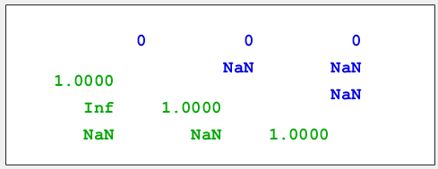
Linear Systems
Visualizer MATLAB

Slide 15
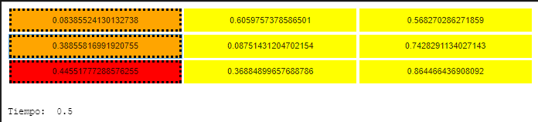
Linear Systems
Visualizer Camilo’s

Slide 16
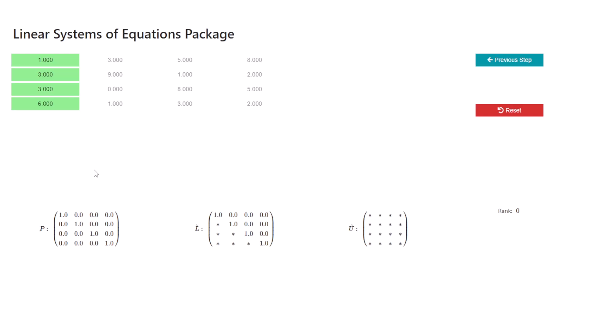
Linear Systems
Visualizer BNumMet

Slide 17
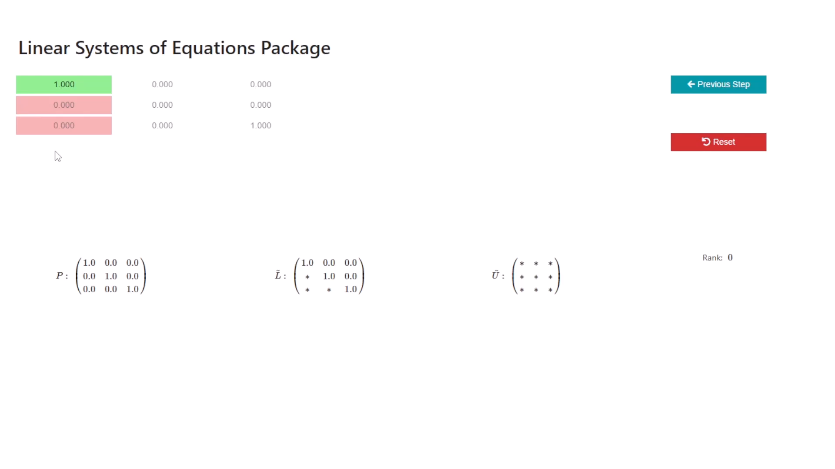
Linear Systems
Visualizer BNumMet

Slide 18
Interpolation
Packages
Polynomial Interpolation
Piecewise Linear Interpolation
Piecewise Cubic Hermite Interpolation
Piecewise Cubic Interpolation

Slide 19
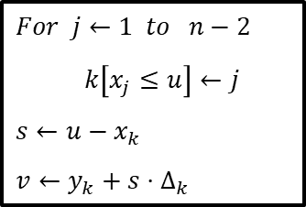
Interpolation
Discussion: Interpolation
List Comprehension
$For j←1 to n−2$
$k\left[x_{j}≤u\right]←j$
$s←u−x_{k}$
$v←y_{k}+s⋅Δ_{k}$
Fancy Indexing

Slide 20
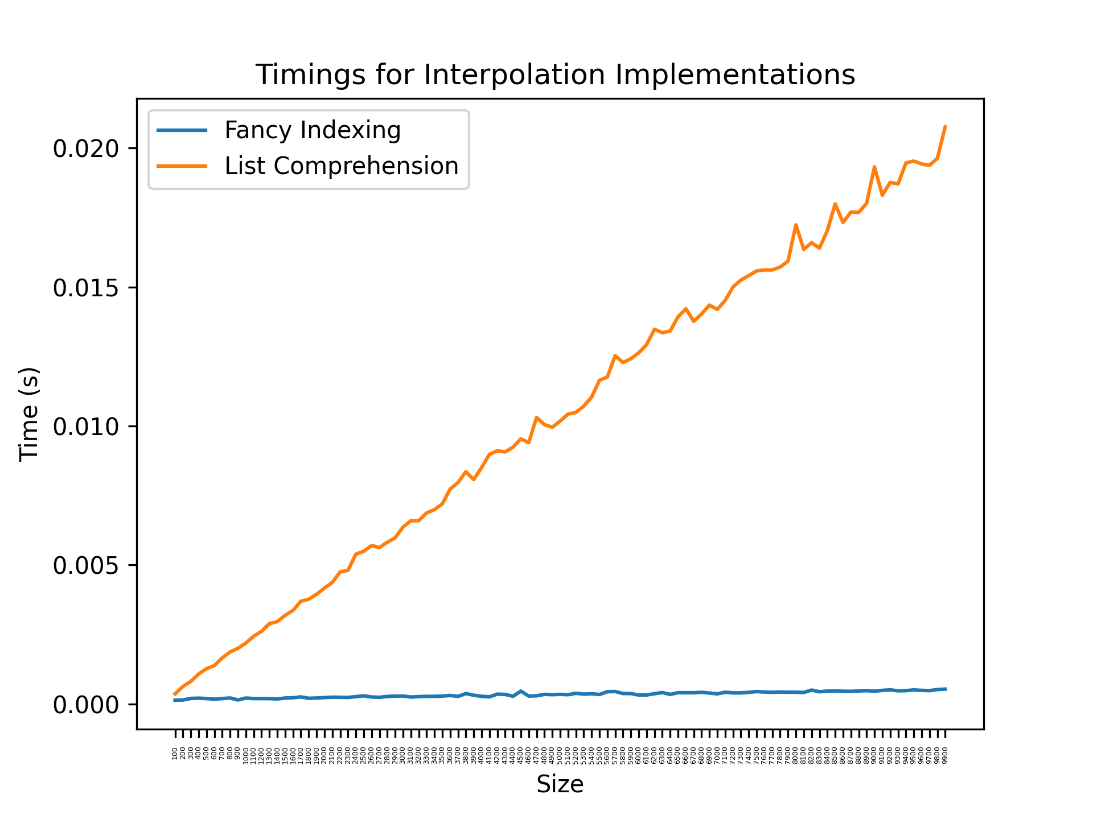
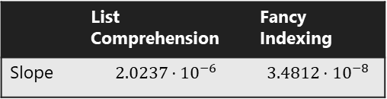
Interpolation
Discussion: Interpolation
 | List Comprehension | Fancy Indexing
Slope | $$2.0237⋅{10}^{−6}$$ | $$3.4812⋅{10}^{−8}$$

Slide 21
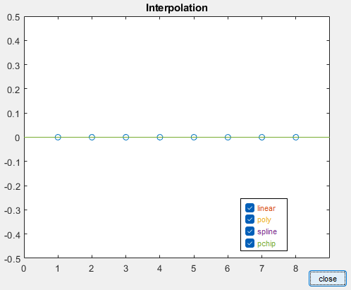
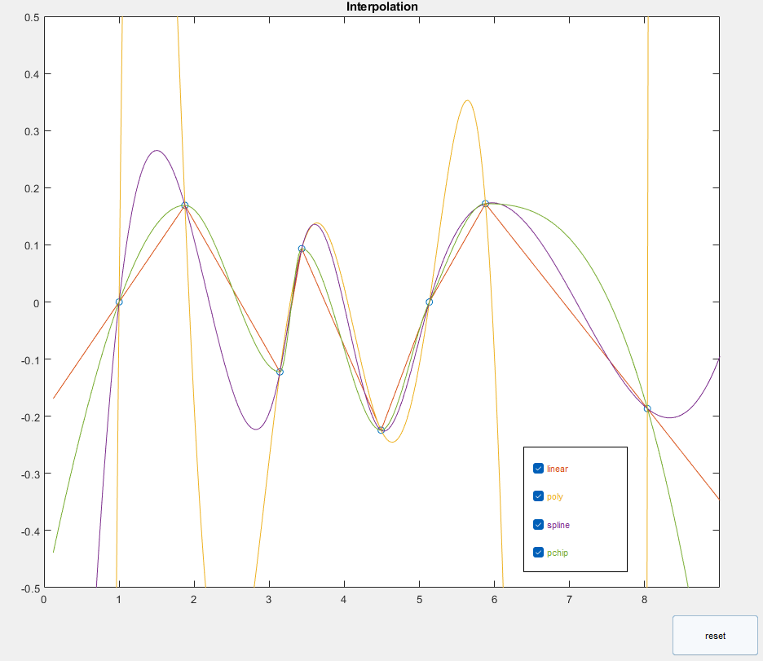
Interpolation
Visualizer MATLAB

Slide 22
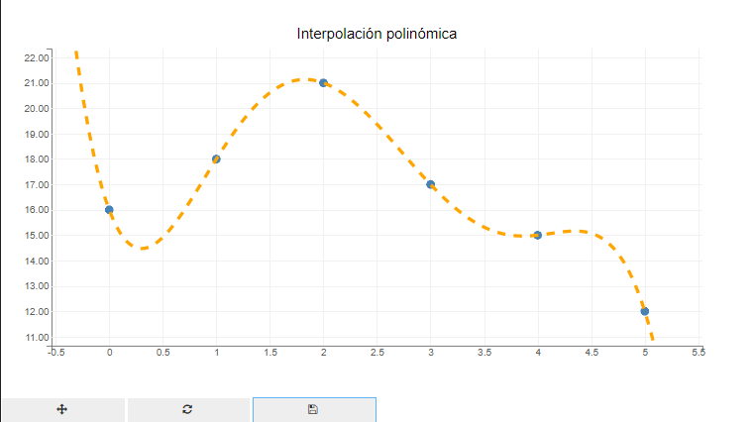
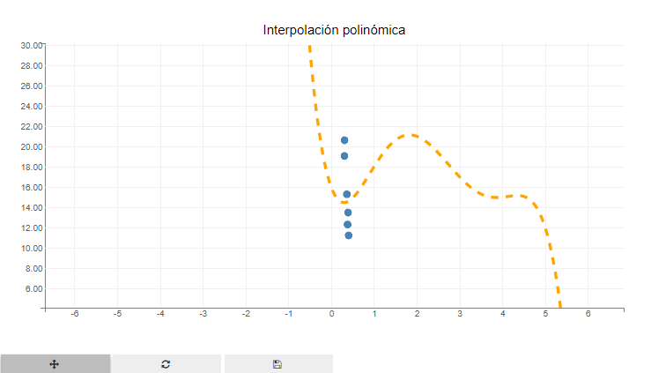
Interpolation
Visualizer Camilo’s

Slide 23
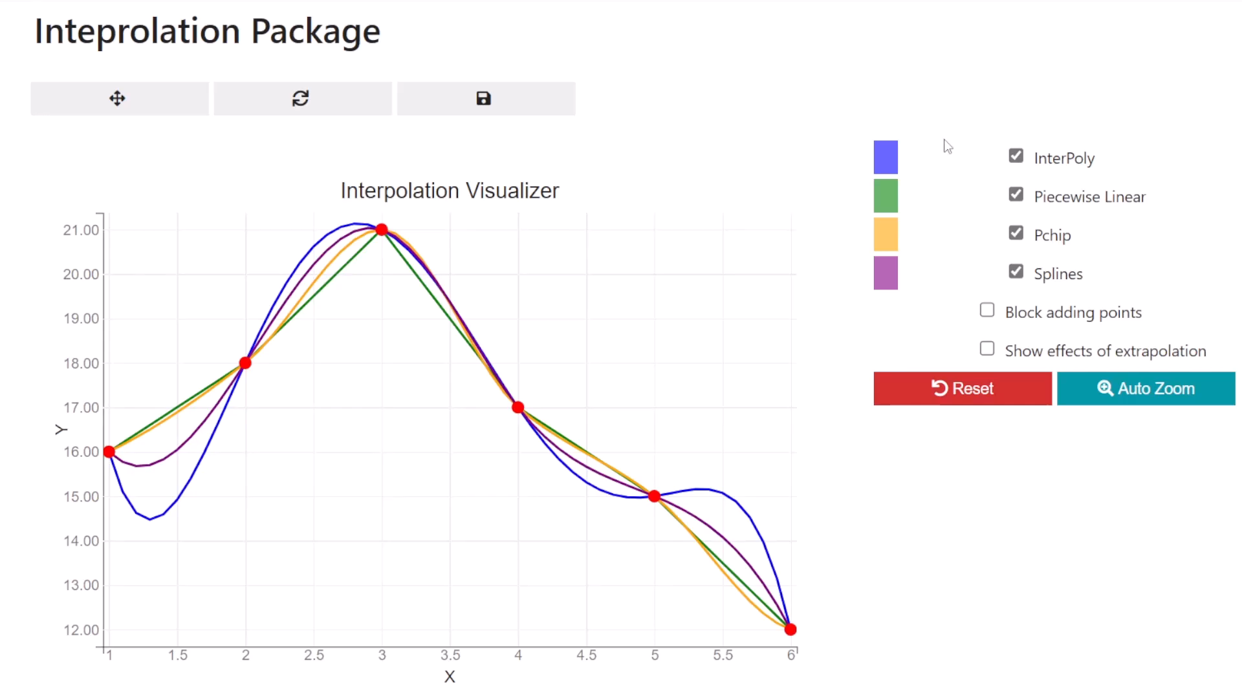
Interpolation
Visualizer BNumMet

Slide 24
Non Linear Equation Solver
Packages
Bisection
Newton’s Method
Secant Method
Inverse Quadratic Interpolation
Brent-Dekker’s Method

Slide 25
Non Linear Equation Solver
Discussion
Original
Brent-Dekker
MATLAB’s
Brent-Dekker
Scipy’s Brent-Dekker

Slide 28
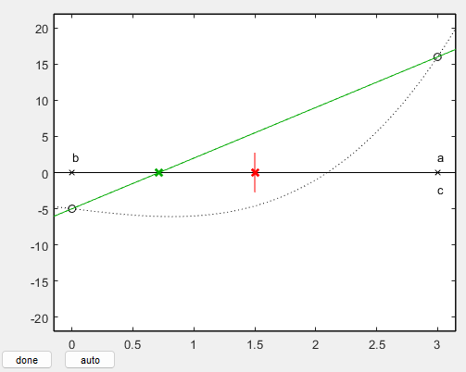
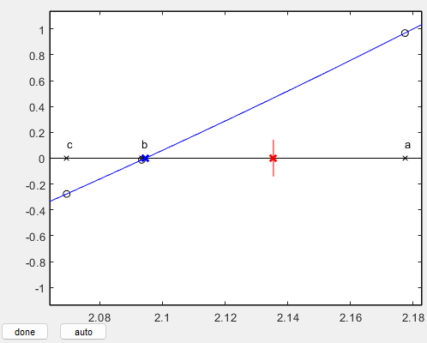
Non Linear Equation Solver
Visualizer MATLAB

Slide 29
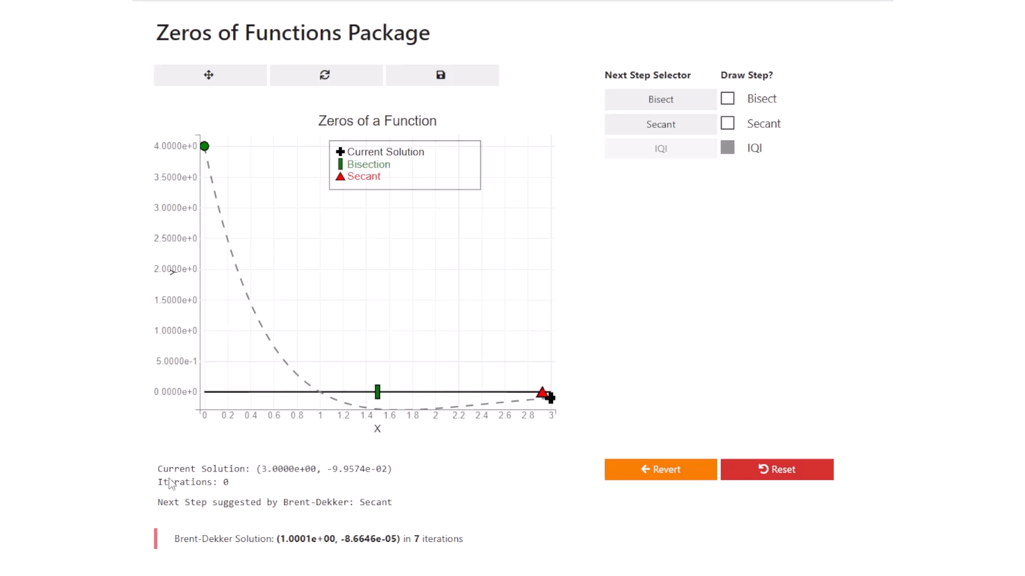
Non Linear Equation Solver
Visualizer BNumMet

Slide 30
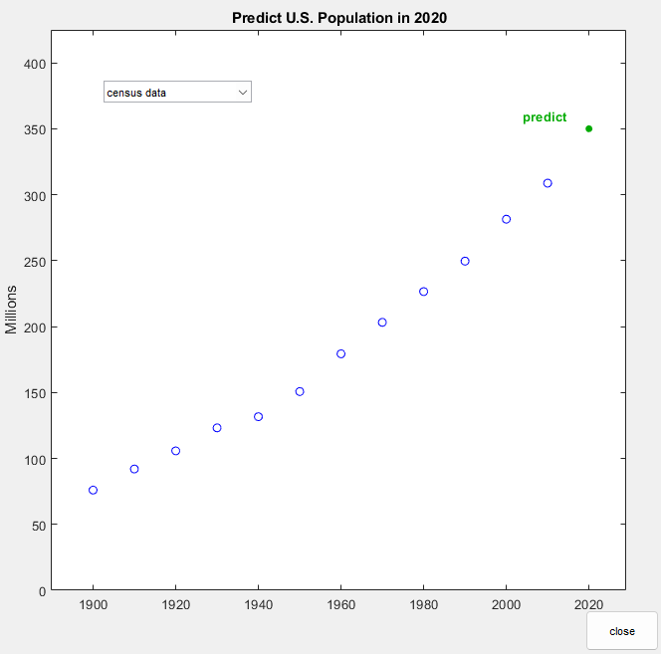
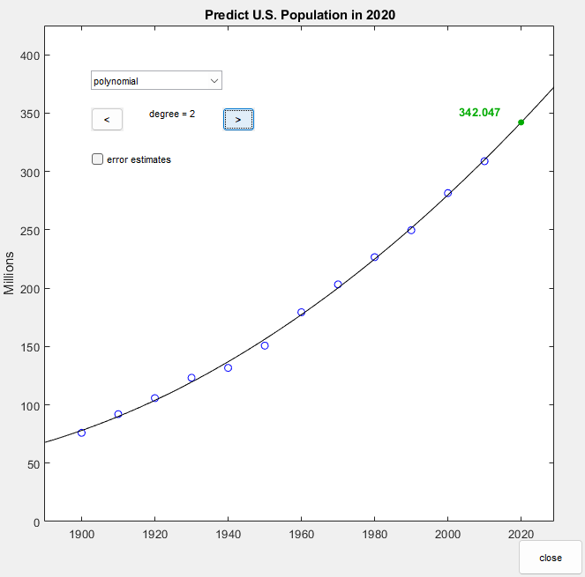
Least Squares
Visualizer MATLAB

Slide 31
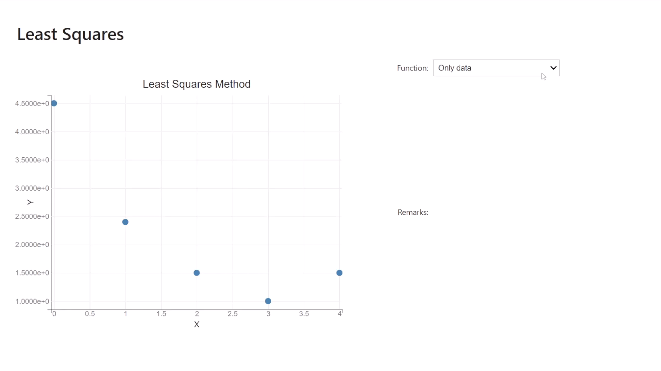
Least Squares
Visualizer BNumMet

Slide 32
Random Number Generators
Packages
Lehmer’s
Linear Congruential Algorithm
$$x_{n+1}=\left(a⋅x_{n}+c\right) mod\left(n\right)$$
𝑥_(𝑛+1)=(𝑎⋅𝑥_𝑛+𝑐) 𝑚𝑜𝑑(𝑛)
Marsaglia’s
Subtract With Borrow or Add with Borrow
$$f\left(x_{1},x_{2},…,x_{r},c\right)=\left\{\begin{aligned}\begin{matrix}(x_{2},…,x_{r},x_{r+1−s}−x_{1}−c,0) & x_{r+1−s}−x_{1}−c≥0\end{matrix} \\ \begin{matrix}(x_{2},{…,x_{r},x}_{r+1−s}−x_{2}−c+b,1) & x_{r+1−s}−x_{1}−c<0\end{matrix}\end{aligned}\right.$$
𝑓(𝑥_1,𝑥_2,…,𝑥_𝑟,𝑐)={█(■8((𝑥_2,…,𝑥_𝑟,𝑥_(𝑟+1−𝑠)−𝑥_1−𝑐,0)&𝑥_(𝑟+1−𝑠)−𝑥_1−𝑐≥0)@■8((𝑥_2,〖…,𝑥_𝑟,𝑥〗_(𝑟+1−𝑠)−𝑥_2−𝑐+𝑏,1)&𝑥_(𝑟+1−𝑠)−𝑥_1−𝑐<0))┤
Mersenne-Twister
Up to date RNG
Used in Python & R

Slide 33
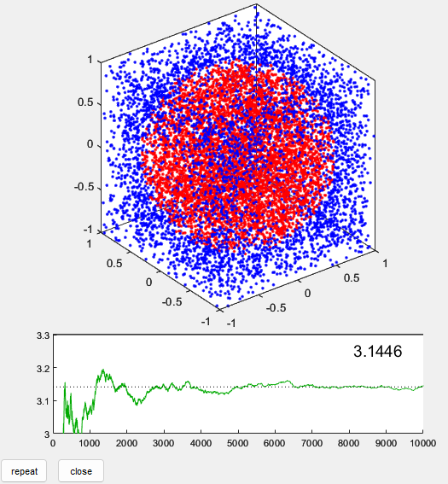
Random Number Generators
Visualizer: Montecarlo

Slide 34
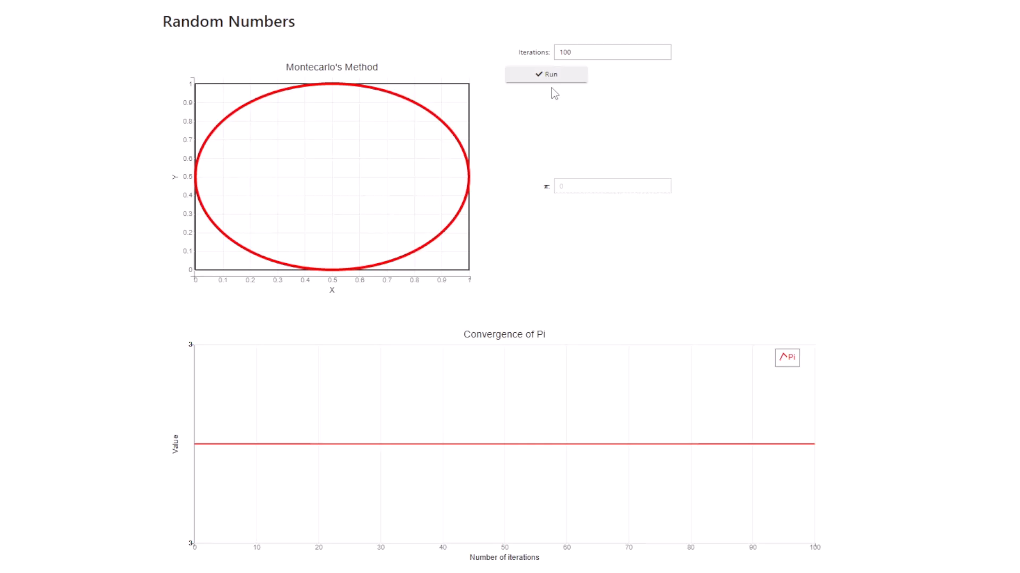
Random Number Generators
Visualizer BNumMet

Slide 35
End of Master’s Thesis: Defense
Thank you for your attention
Any questions?
NAME
Fernando Bellido Pazos
MAIL
fbellidopazos@gmail.com
MASTER
Applied & Computational Mathematics
TUTOR
Juan Manuel Perez Pardo

